Slide 1
EMERGING MARKETS INSTITUTE
Encouraging Dialogue, Building bridges
Lourdes Casanova Gail and Rob Cañizares Director, Emerging Markets Institute
January 2021
Cornell SC Johnson College of Business 1

Slide 2
EMI MISSION: EDUCATION, OUTREACH, KNOWLEDGE
Education
Outreach
Knowledge
Conference Nov. 5:
https://bit.ly/EMIConference2020
5th Case Competition Africa firm going global
Second Pitch competition
T-Time/EMagine with Emerging Markets
Blogs/ Social Media/ Newsletter/ EMI fellows Alumni
L. Casanova
Anne Miroux
Emerging Market Multinationals Report 2020 10 years that changed emerging markets
2021 ESG
We review E20, the biggest emerging Markets and also emerging multinationals
Case Studies
EMI Fellows: 2nd Year Concentration/Intensive
10% of the class follow a ‘concentration’ on Emerging Markets
Cornell Tech and eMBA students have joined
Cornell SC Johnson College of Business 2

Slide 3
2020 EMI Fellows Graduation
2020 | COLUMN
Full time MBAs | 33
Executive MBA programs | 11
Cornell Tech | 13
CIPA | 3
Baker Program in Real Estate | 1
Undergraduate | 1
Total | 62
Cornell SC Johnson College of Business 3

Slide 4
AGENDA
1
REQUIREMENTS EMI FELLOWS
For Full time MBA: 2 year, AMBA and Cornell Tech
For eMBA, Cornell Americas, MS/Health
SPRING SEMESTER
Webinars
2
2021 CONFERENCE ON NOVEMBER 5
ESG Theme
Case competition
Pitch competition
3
PROGRAM CHAIRS
Chairs
10th anniversary survey
4
HOW TO MAKE EMI MEANINGFUL/WORK ACROSS PROGRAMS?
5
Cornell SC Johnson College of Business 4

Slide 5
REQUIREMENTS EMI FELLOWS
Cornell SC Johnson College of Business 5

Slide 6
REQUIREMENTS EMI FELLOWS
Preparing high performing MBA students for careers in/with emerging markets
Minimum of 6 academic credits (4 credits for AMBAs or Cornell Tech)
2-YEAR MBAS/AMBAS/Cornell Tech
Mandatory Courses
Study Trip or Internship
Attending EMI Conference
Service EMI (sign up to)
One required to an emerging market
Credits on trip/internship not counted towards academic credits
Write a 1,000 words blog for the EMI website
Participate in the organization of the EMI Conference
Participate in EMI’s research projects
Be Social Media Ambassadors/T-time (videos)
NBA 6440 Emerging Multinationals (1.5 credits), cancelled this year
NBA 5260 Leaders in Emerging Markets or Attending the EMI conference (1 credit)
SAVE THE DATE NOVEMBER 5TH
Cornell SC Johnson College of Business 6

Slide 7
REQUIREMENTS EMI FELLOWS
Suggested courses
2-YEAR MBAS/AMBAS
NBA 6440
Disruptive Innovators from China & Other Emerging Markets
NBA 5260
Leaders in Emerging Markets
NBA 5410
Project Management
NBA 5690
Management Consulting Essentials
NBA 5740
Management Practicum
NBA 5795
Advanced Strategic Analysis
NBA 5810
Management Cases
NBA 6150
Business Chinese in Cultural Context I
NBA 6190
Leaders in Sustainable Global Enterprise
NBA 6980
International Trade and WTO Law
NBA 5130
International Finance Cases
NBA 5245
Introduction to Macroeconomics
NBA 6370
Current Global issues for Business
NBAY 5550
Entrepreneurship and Alternative Finance in Emerging Economies
NBA 6530
Strategic Alliances
Courses are not limited to the ones above and change every year. Suggestions are welcome
Cornell SC Johnson College of Business 7

Slide 8
REQUIREMENTS EMI FELLOWS
Suggested courses Cornell Tech
CORNELL TECH & eMBA
NBAY 5550
Entrepreneurship and Alternative Finance in Emerging Economies
NBAY 6660
Negotiations
NBAY 5240
Macroeconomics & International Trade
INFO 5330
Technology, Media and Democracy
NBAY 5100
Social Entrepreneurship
NBAY 6130
Women Leading in Tech
NBAY 5300
Entrepreneurial finance
NBA 5670
Management Writing
NBA 5680
Management Presentations
NBAY 5550
Entrepreneurship and Alternative Finance in Emerging Economies
Courses are not limited to the ones above and change every year. Suggestions are welcome
Cornell SC Johnson College of Business 8

Slide 9
REQUIREMENTS EMI FELLOWS
Preparing high performing MBA students for careers in/with emerging markets
eMBA/Cornell Americas/MS/Health
Capstone Project on an emerging market multinational (in team of 4). Due April 15
Attending EMI Conference
Service EMI
Summary of the company: focus on analysis, not only description
Context
Dilemmas/challenges the company faces
Reasons for success/failure
Recommendations (give your opinion)
Meet Lourdes when topic has been decided (invite through https://calendly.com/lc683)
Write a 1,000 words blog for the EMI website
Participate in the organization of the EMI Conference
Be Social Media Ambassadors/T-time (videos)
SAVE THE DATE NOVEMBER 5TH
Course with international focus
eMBA: Emerging Multinationals elective
MS/Health and Cornell Americas:
Global perspectives in Healthcare
Cornell SC Johnson College of Business 9

Slide 10
REQUIREMENTS EMI FELLOWS: BLOG
1,000 words article for the EMI website guidelines
Personal voice with focus on business and economy
140-character excerpt with summary of the article
Formatting should include headings and distinct paragraphs to break up text
Two hyperlinks to Cornell’s websites
A max. 100-word bio
Include featured image, displayed at the top of the story (600 pixels, horizontal, png or jpeg)
Articles are reviewed by EMI team and finally approved by Johnson’s Marketing team
Cornell SC Johnson College of Business 10

Slide 11
SPRING SEMESTER
Cornell SC Johnson College of Business 11

Slide 12
SPRING SEMESTER Webinars: Building Bridges, encouraging dialogue across Latin America, Africa, China and India Anirudh Aggarwal & Gaurav Trivedi
WEBINARS
Schedule
Organizer(s)
EMI Report official launch
Registration https://www.ecornell.com/keynotes/overview/K020821a/
February 8 at noon
Gaurav Trivedi
Tyler Botzon
Onyinye Akujuo
Hawkins Etidau
Nnamdi Iwuji
Ivy Ochieng, Efua
Africa
February 19
Latin America – LASP, LABA
March 22
Maria Peña
Anirudh Aggarwal
Vinit Kicha
Vidya Rajagopalan
India
April 22
Joy Xiao
Max (Hao-Tun) Kao
Minwei Cao
China w/ Cornell China Center
May
Cornell SC Johnson College of Business 12

Slide 13
2021 Emerging Markets Theme Seminar Series
Ricardo Hausmann Feb 5, 2021 at 12:00-1:00 pm The knowhow approach to Economic Development, Director of the Growth Lab at Harvard's Center for International Development and the Rafik Hariri Professor of the Practice of International Political Economy at Harvard Kennedy School and phD in Economics from Cornell University Please register https://cornell.zoom.us/webinar/register/WN_z52sJNraR8-rW4qDwnr97A
Johanna Mair Mar 2, 2021 at 12:00-1:00 pm - https://pacscenter.stanford.edu/person/johanna-mair/ Professor of Organization, Strategy and Leadership at the Hertie School of Governance, the Codirector of the Global Innovation for Impact Lab at the Stanford Center on Philanthropy and Civil Society, and the Academic Editor of the Stanford Social Innovation Review. Please register at https://cornell.zoom.us/webinar/register/WN_-_ls5660QgabbdEbdB-29g
Claudio Ferraz Apr 2, 2021 at 12:00-1:00 pm Professor, Scientific Director for Latin America. Vancouver School of Economics. University of British Columbia. Please register at- https://cornell.zoom.us/webinar/register/WN_skv8i4-3S_elrPOpI28y-w
TJ Wong, May 7, 2021 at 12:00-1:00 pm - Joseph A. DeBell Professor of Business Administration and Professor of Accounting. Expert on Corporate Governance in Emerging Markets. USC Marshall School of Business. Please register at https://cornell.zoom.us/webinar/register/WN_goiuP1n7SUGaKGKl7PUrrQ
This is a Cornell S. C. Johnson College of Business initiative with Interim Directors: Arnab Basu, Lourdes Casanova and Christopher Marquis https://business.cornell.edu/faculty-research/themes/emerging-markets-theme/

Slide 14
EMI Graduation Ceremony
MAY 28TH
^{2pm}
VIP Speaker
Student speakers
One student per program
Chairs: Vinit Khicha, Susan Lin
Cornell SC Johnson College of Business 14

Slide 15
On November 5th
2021 EMI CONFERENCE
Cornell SC Johnson College of Business 15

Slide 16
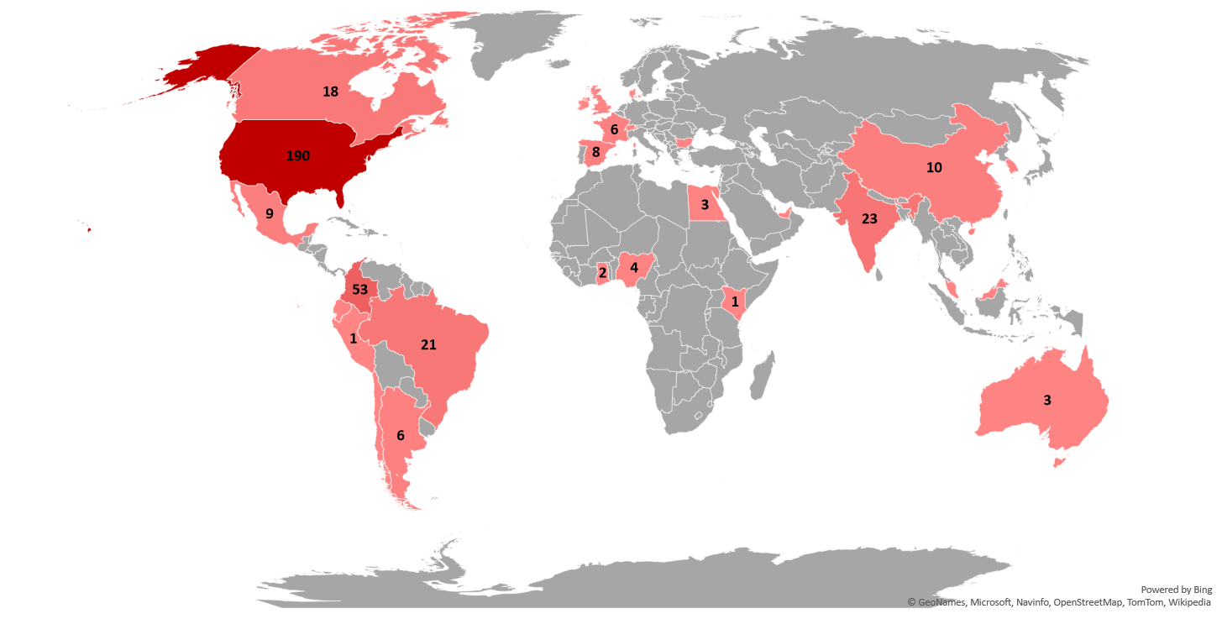
EMI Conference 2020 Attendance
ALMOST 400
UNIQUE PARTICIPANTS
IN THREE DAYS
29
COUNTRIES from ALL THE WORLD REGIONS
More than 90
ACADEMIC AND BUSINESS INSTITUTIONS
Cornell SC Johnson College of Business 16

Slide 17
NOV 5TH
2021 EMI CONFERENCE
Live in Ithaca (?)
Theme: Environmental, Social, and Corporate Governance (ESG)
Chairs: Chris Magas, Daita Goswamy, Joy Xiao, David Roosevelt, Gleb Margolin
Speakers
Funding
5th Case Competition
2nd Pitch Competition
Chris Magas
Ramin Karbasi
Anirudh Aggarwal
Amanda Ward
Develop Case: African company going global
Rebecca Greenway
Daita Goswamy
Cornell SC Johnson College of Business 17

Slide 18
PROGRAM CHAIRS
Cornell SC Johnson College of Business 18

Slide 19
EMI Fellows Chairs 2021-2022
2-year MBA 2021 Maria Peña
2-year MBA 2022 Daita Goswamy, Mariana Flores, Jaco D Aiken-Phillips
AMBA Amanda Ward, Kutlwano Mzwinila, Omkar Parab, Kavitha Ramaswamy, Arif Yardimci, Max (Hao-Tun) Kao, Austin Issac
Cornell Tech Harkiran Sodhi, Eme Bassey, Hajer Tamimi, Tole David Mwawuganga, AV Taylor, Zuhayr Reaz
eMBA 2021 Maiko Minami, Sophia van Doren
eMBA 2022 Daniel Johnson, Rachel Bassignani
Ms/Health 2021 Pearl Philips
Ms/Health 2022 Vidya Rajagopalan, Madalina, Sucala, Mary Zhang, Evan Shreiber
Cornell Americas 2021 Nikita Sarkar, Efua E. Ihenjen, Aliyya Shelley Mattos,
Cornell Americas 2022 David Roosevelt, Efua E Ihenjen, Onyinye Akujuo
CIPA Cosmas Emeziem
Cornell SC Johnson College of Business 19

Slide 20
EMI fellows activities
Supporting EMI in strategy and marketing roles
Social Media
EMI Strategic Review Surveys EMI’s 10th anniversary
With support of the current EMI team (Mumuksha Kicha)
Ivy Ochieng
Rebecca Greenway
Conference
Chris Magas, Daita Goswamy, Joy Xiao, David Roosevelt
EMIfellows: https://johnson.qualtrics.com/jfe/form/SV_8oYAMKx8ChRA7u5
Alumni: https://johnson.qualtrics.com/jfe/form/SV_escQvJIlBsW7Cfj
Faculty: https://johnson.qualtrics.com/jfe/form/SV_1HRnrYYnWr1pMdD
Executives: https://johnson.qualtrics.com/jfe/form/SV_2hruwNiMSFOI27r
Cornell SC Johnson College of Business 20

Slide 21
Social Media at a Glance: Jan 24th-Dec 20th, 2020 Growth
Mumuksha Khicha
Jan, 24
633
704
<4,632
1,891
2,058
89
May, 24
771
1,164
4,994
1,922
2,096
122
Dec, 20
1,015
1,862
5,361
1,961
2,136
215
Since May
+244
followers
+698
followers
+367
followers
+39
followers
+40
followers
+93
subscribers
YTD%
+60%
+164%
+16%
+4%
+4%
+142%
Cornell SC Johnson College of Business 21

Slide 22
Social Media Series
a. EMs Milestones
d. Articles / News
from WSJ, Bloomberg, etc
g. Emerging Markets Country Spotlight
b. Testimonials
e. Behind the scenes / team at work
h. Graphs / research post from EMR 2020
c. EMI Blogs
f. Faculty member and Advisory Board Highlight
i. Looking Back and Moving Forward Interview series
Cornell SC Johnson College of Business 22

Slide 23
Here’s how you can contribute:
Suggestions for new series idea for social media
Like, share and comment on our social media posts
Taking up our Insta story
PLEASE
FOLLOW, SHARE, SUBSCRIBE TO ALL OUR SOCIAL MEDIA PLATFORMS
To help grow our network, we encourage you to add EMI Fellow credentials on LinkedIn: EMI Fellow at Cornell Emerging Markets Institute
When you post, please tag #cornellEMI #cornellMBA
Title: EMI Fellow
Account linked to Title of Position: Cornell Emerging Markets Institute (NOT Cornell College of Business Emerging Markets Institute)
Cornell SC Johnson College of Business 23
Notes:
Title: <Your Position> (e.g. Research Assistant, Project Manager, etc.)
Account linked to Title of Position: Cornell Emerging Markets Institute (NOT Cornell College of Business Emerging Markets Institute)
If your current position is linked to Cornell College of Business Emerging Markets Institute, please edit it to Cornell Emerging Markets Institute. Although both names lead to the same page, it helps with consistency if we all use the same name.
If you choose to include this position as your headline for Linkedin, please use: <position> at Cornell Emerging Markets Institute
Please go through our social media platforms (links in the signature)
Suggest new social media series related to emerging markets. In the past, we have worked on series like startups in EMs, Fun facts about EMs, EM country spotlight, etc
Please follow, like, share, comment for outreach and engagement. Also, If you like our posts, we encourage you to share it with your friends and family!
Suggest ways to increase followers and reach more people.
Please add your credentials on LinkedIn as an EMI fellow at ‘Cornell Emerging Markets Institute’

Slide 24
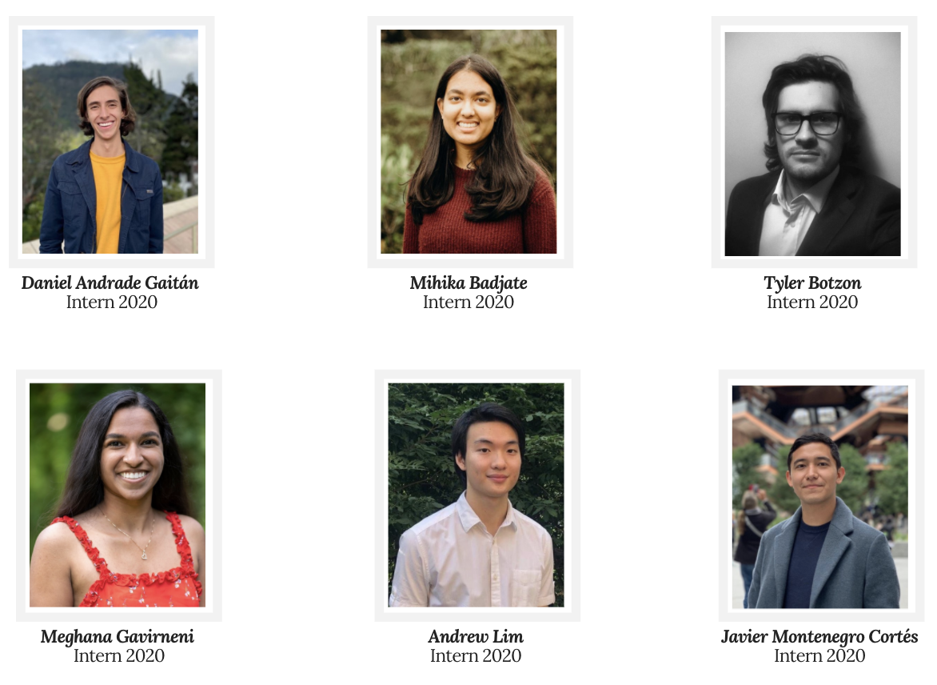
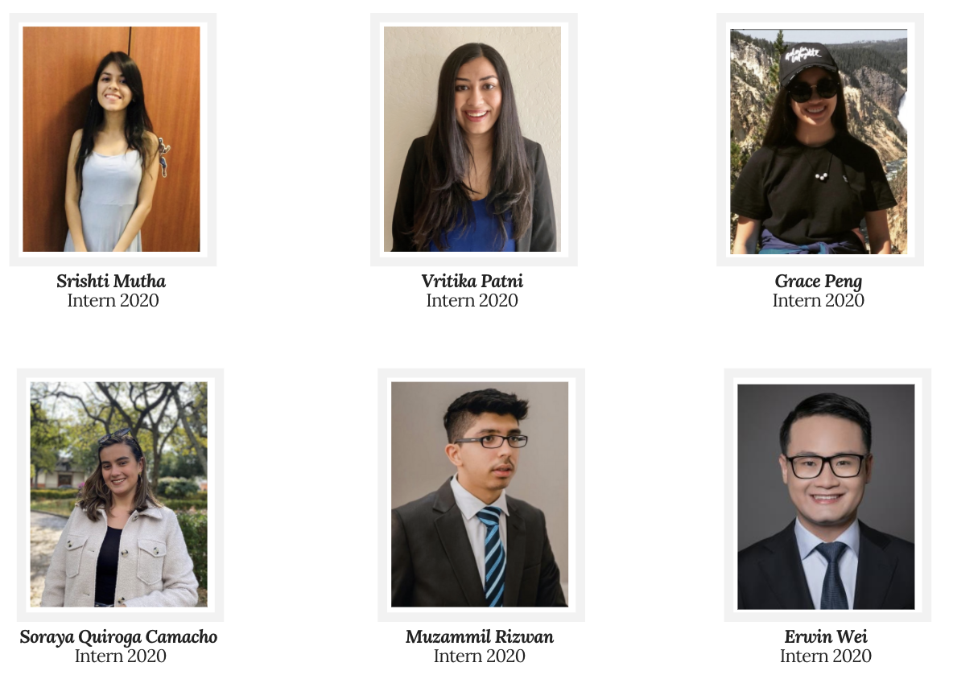
Summer Internship
Vritika Patni, Mihika Badjate
Cornell SC Johnson College of Business 24

Slide 25
Summer Interns 2020
12 interns, 6+ countries: India, Colombia, Hong Kong, Abu Dhabi, China, US
Two internship tracks: research and marketing
Projects undertaken:
EMI country rankings, Milestones, China-Africa debt crisis research, Global and multilateral initiatives and companies vignettes
Social media rebranding, 10th anniversary videos, task forces (some led by interns), summer newsletter
Blog posts
Research
Capital IQ/World Bank/Bloomberg/others for the EMI annual report
Economic policies and trends in emerging market economies
Work on miscellaneous business style writing projects, with potential for publication on the EMI website and Johnson Business Feed
Communication and presentation skills
Hone in on your business writing
Marketing
Develop strategy to maximize outreach within Cornell community and beyond
Maintain social media pages by designing new posts via Canva, and brainstorming/implementing new series ideas
Edit videos to be featured on social media pages, and edit interviews to be featured on our YouTube account
Write blog posts covering events/conferences the institute partakes in, to be ultimately featured on the EMI website
Cornell SC Johnson College of Business 25

Slide 26
Summer Interns Insights
Standardizing the application process and maximizing reach
Dyson, Hotel, Arts and Sciences specific newsletters; economics department newsletter; undergraduate business club circuit
Button attached to Google form on EMI website for application
Interviews of applicants conducted by previous intern class
Internship Timeline
Potential rotation between marketing and research tracks?
Training opportunities: database workshops, Excel, Canva
Mandatory workshops for training in databases (i.e. Bloomberg, Capital IQ)
Speaker series and networking opportunities for undergraduates
Weekly presentation of materials to hone on public speaking
Cornell SC Johnson College of Business 26

Slide 27
Newsletter Reach
November 2020 | COLUMN
Sent / Delivery | 14,706 / 14,681 (99.8%)
Open / Unique open | 9,838 / 5,114 (34.8% of total)
Clicks / Unique clicks | 181 (1.2%) / 125 (0.9%)
Clicks to open ratio | 3.3% of total open
Bounces | 16 soft / 9 hard
Opt outs | 17
Spam complaints | 1
December 2020 | COLUMN
Sent / Delivery | 14,621 / 14,581 (99.7%)
Open / Unique open | 3,834 / 2,794 (19.2% of total)
Clicks / Unique clicks | 94 (0.6%) / 52 (0.4%)
Clicks to open ratio | 1.9% of total open
Bounces | 16 soft / 9 hard
Opt outs | 27
Spam complaints | 1
Cornell SC Johnson College of Business 27

Slide 28
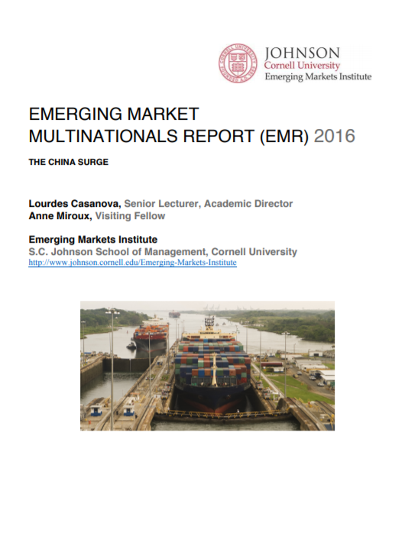
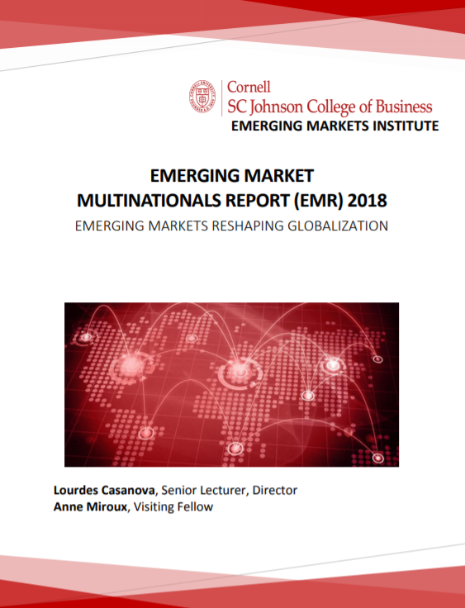
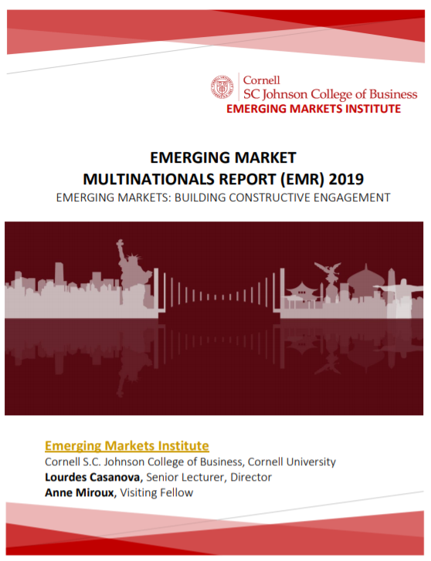
Emerging Market Multinationals Report
ALMOST 4,500
DOWNLOADS IN 2020
FROM:
U.S.
EUROPE
CHINA
PHILIPPINES
INDIA
COLOMBIA
https://ecommons.cornell.edu/handle/1813/66953
Cornell SC Johnson College of Business 28

Slide 29
How to make EMI more meaningful across programs?
Cornell SC Johnson College of Business 29

Slide 30
THANK YOU
https://www.johnson.cornell.edu/emerging-markets-institute/
https://ecommons.cornell.edu/handle/1813/66953
Lourdes Casanova Gail and Rob Cañizares Director, Emerging Markets Institute

